Slide 1
Simple Linear Regression In r
An example

Slide 2
Input Data
Data is on survey information on a variety of car makes and models.
This file is available from http://www.imperial.ac.uk/bio/research/crawley/statistics

Slide 3
Price Country Reliability Mileage Type Weight Disp. HP
8895 USA 4 33 Small 2560 97 113
7402 USA 2 33 Small 2345 114 90
6319 Korea 4 37 Small 1845 81 63
6635 Japan/USA 5 32 Small 2260 91 92
6599 Japan 5 32 Small 2440 113 103
8672 Mexico 4 26 Small 2285 97 82
7399 Japan/USA 5 33 Small 2275 97 90
7254 Korea 1 28 Small 2350 98 74
9599 Japan 5 25 Small 2295 109 90
5866 Japan NA 34 Small 1900 73 73
8748 Japan/USA 5 29 Small 2390 97 102
6488 Japan 5 35 Small 2075 89 78
9995 Germany 3 26 Small 2330 109 100
11545 USA 1 20 Sporty 3320 305 170
9745 USA 1 27 Sporty 2885 153 100
12164 USA 1 19 Sporty 3310 302 225
11470 USA 3 30 Sporty 2695 133 110
9410 Japan 5 33 Sporty 2170 97 108
13945 Japan 5 27 Sporty 2710 125 140
13249 Japan 3 24 Sporty 2775 146 140
10855 USA NA 26 Sporty 2840 107 92
13071 Japan NA 28 Sporty 2485 109 97
18900 Germany NA 27 Compact 2670 121 108

Slide 4
We will use to illustrate simple linear regression
And later to illustrate multiple regression

Slide 5
Exploratory data analysis
> summary(data)
Price Country Reliability Mileage Type
Min. : 5866 USA :26 Min. : 1.000 Min. :18.00 Compact:15
1st Qu.: 9932 Japan :19 1st Qu.: 2.000 1st Qu.:21.00 Large : 3
Median :12216 Japan/USA: 7 Median : 3.000 Median :23.00 Medium :13
Mean :12616 Korea : 3 Mean : 3.388 Mean :24.58 Small :13
3rd Qu.:14933 Germany : 2 3rd Qu.: 5.000 3rd Qu.:27.00 Sporty : 9
Max. :24760 France : 1 Max. : 5.000 Max. :37.00 Van : 7
(Other) : 2 NA's :11.000
Weight Disp. HP
Min. :1845 Min. : 73.0 Min. : 63.0
1st Qu.:2571 1st Qu.:113.8 1st Qu.:101.5
Median :2885 Median :144.5 Median :111.5
Mean :2901 Mean :152.1 Mean :122.3
3rd Qu.:3231 3rd Qu.:180.0 3rd Qu.:142.8
Max. :3855 Max. :305.0 Max. :225.0

Slide 6
We will use price as our response variable Y
Mileage will be the independent variable X

Slide 7
Scatterplot Y v. X
plot(Price~Mileage,main="Price by Mileage")

Slide 8
Use lm to do the regression
lmodel<-lm(Price~Mileage,data)
>
> summary(lmodel)
Call:
lm(formula = Price ~ Mileage, data = data)
Residuals:
Min 1Q Median 3Q Max
-4016.0 -1835.9 -873.9 1482.5 9591.1
Coefficients:
Estimate Std. Error t value Pr(>|t|)
(Intercept) 26310.31 2119.90 12.41 < 2e-16 ***
Mileage -557.07 84.67 -6.58 1.48e-08 ***
---
Signif. codes: 0 ‘***’ 0.001 ‘**’ 0.01 ‘*’ 0.05 ‘.’ 0.1 ‘ ’ 1
Residual standard error: 3116 on 58 degrees of freedom
Multiple R-squared: 0.4274, Adjusted R-squared: 0.4175
F-statistic: 43.29 on 1 and 58 DF, p-value: 1.484e-08

Slide 9
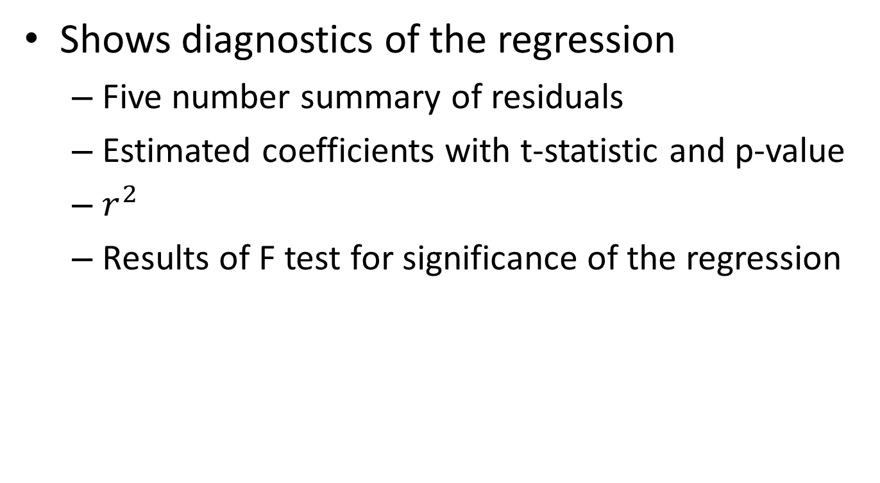
summary()
Shows diagnostics of the regression
Five number summary of residuals
Estimated coefficients with t-statistic and p-value
$r^{2}$
Results of F test for significance of the regression

Slide 10
Other
c<-coef(lmodel)
this command shows the coefficients of the linear model. Here I have assigned the coefficients to vector c.

Slide 11
Add the regression line to the scatterplot
abline(coef=c)

Slide 12
Predicted values
pred<-predict(lmodel)
Here I have assigned the predicted values to vector pred

Slide 13
Residuals
resi<-residuals(lmodel)
Here I have assigned the residuals to vector resi

Slide 14
SSR sum of squares residuals
deviance(lmodel)
[1] 563187072

Slide 15
To get the degrees of freedom for the SSR
> df.residual(lmodel)
[1] 58

Slide 16

Estimate of $σ^{2}$
deviance(lmodel)/df.residual(lmodel)
[1] 9710122

Slide 17
From Summary
We can also get many of these values from the summary as
lmodelsum<-summary(lmodel)
est.sigma<-lmodelsum$sigma
lmodelsum$r.squared
lmodelsum$adj.r.squared

Slide 18
ANOVA
anova(lmodel)
Analysis of Variance Table
Response: Price
Df Sum Sq Mean Sq F value Pr(>F)
Mileage 1 420364425 420364425 43.291 1.484e-08 ***
Residuals 58 563187072 9710122

Slide 19
Confidence intervals for the coefficients
confint(lmodel)
2.5 % 97.5 %
(Intercept) 22066.884 30553.7462
Mileage -726.548 -387.5929

Slide 20
par(mfrow=c(2,2) plot(lmodel)

Slide 21
Our own residual check
par(mfrow=c(1,1))
plot(resi~Mileage, main="plot of residuals vs X")

Slide 22
Look for patterns

Slide 23
Residuals versus Predicted
plot(resi~pred, main="plot of residuals vs predicted")

Slide 25
Plot indicates possible non-constant variance
Try a transformation
Y<-log(Price)

Slide 26
Fit the log data
tlmodel<-lm(Y~Mileage)
> summary(tlmodel)
Residuals:
Min 1Q Median 3Q Max
-0.32881 -0.15038 -0.06372 0.13520 0.57814
Coefficients:
Estimate Std. Error t value Pr(>|t|)
(Intercept) 10.636580 0.150549 70.652 < 2e-16 ***
Mileage -0.050659 0.006013 -8.425 1.19e-11 ***
---
Residual standard error: 0.2213 on 58 degrees of freedom
Multiple R-squared: 0.5503, Adjusted R-squared: 0.5426
F-statistic: 70.99 on 1 and 58 DF, p-value: 1.191e-11

Slide 27
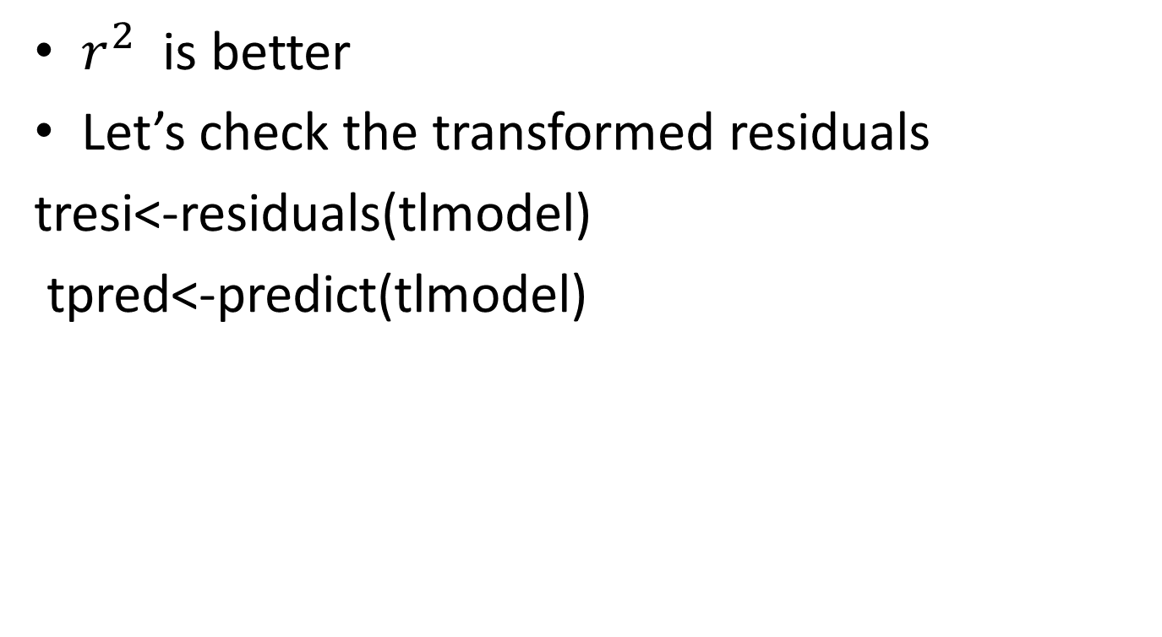
Better fit
$r^{2}$ is better
Let’s check the transformed residuals
tresi<-residuals(tlmodel)
tpred<-predict(tlmodel)

Slide 28
Check residuals verus X for linear fit
plot(tresi~Mileage, main="Plot of residuals vs X, transformed data")

Slide 30
Plot residuals versus predicted for transformed Y
plot(tresi~tpred, main="plot of residuals vs predicted, transformed")

Slide 32
Check for normality on transformed data
> qqplot(tresi,rnorm(length(tresi)))

Slide 34
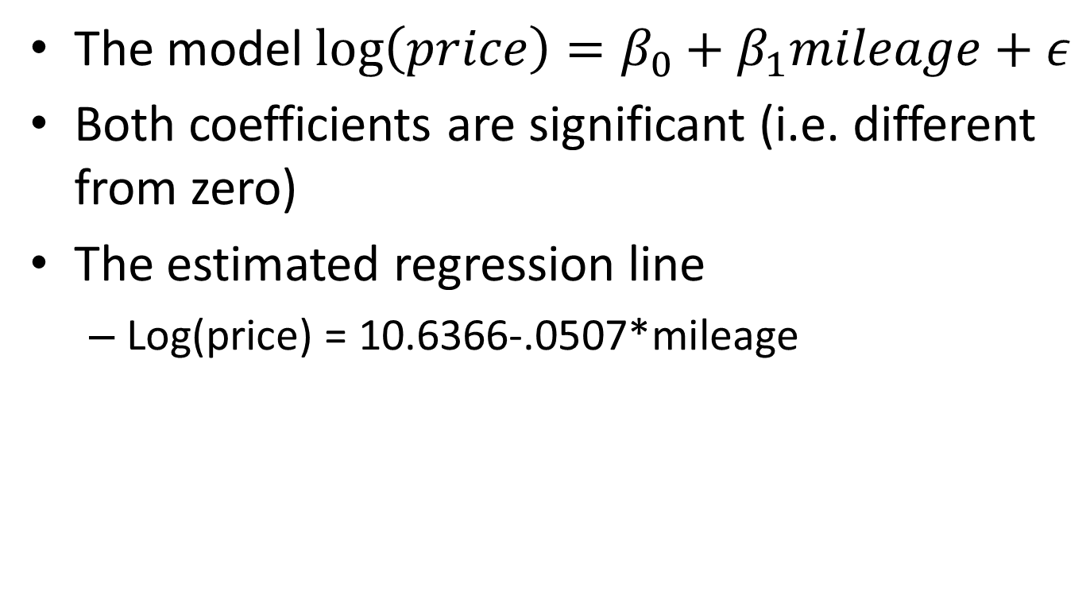
Conclusion
The model $\log\left(price\right)=β_{0}+β_{1}mileage+ε$
Both coefficients are significant (i.e. different from zero)
The estimated regression line
Log(price) = 10.6366-.0507*mileage

Slide 35
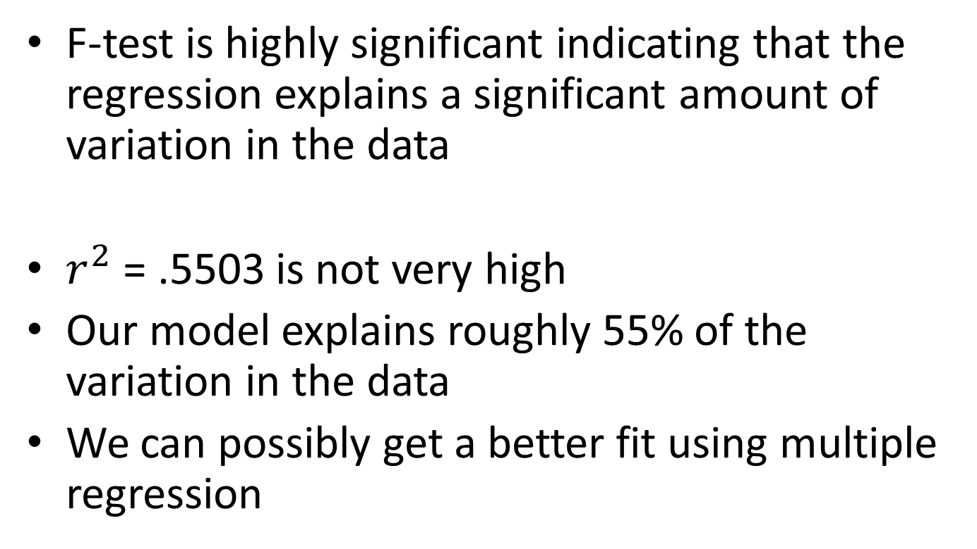
F-test is highly significant indicating that the regression explains a significant amount of variation in the data
$r^{2}$ = .5503 is not very high
Our model explains roughly 55% of the variation in the data
We can possibly get a better fit using multiple regression

Slide 36
Residual analysis
There was a potential non-constant variance issue and so the response variable was transformed to Y=log(price)
The price variable was considerably larger in magnitude than the independent variable, mileage, making the log transformation reasonable computationally

Slide 37
Plot of residual versus X showed no pattern, so there is no reason to think a higher term in mileage would be helpful

Slide 38
Plot of residuals versus predicted on the transformed data showed no problems indicating the assumption of constant variance is not violated using the transformed data

Slide 39
qq plot of residuals looked ok, so the normal assumption is not violated.
No time information is available to check for serial dependence

